Slide 1
FOURIER ANALYSIS OF SIGNAL
Vishwakarma Institute of Technology, Pune-37
Department of Electronics and Telecommunication Engineering
Presentation-I
Presented By-
Name 1 (Roll No.)
Name 2 (Roll No.)
Name 3 (Roll No.)
Guided By-
Prof. M. S. Deshpande

Slide 2
Outline
Abstract
Literature survey
Objectives
Methodology
GUI View
Applications
Time Plan
References

Slide 3
Abstract
In this project we will be presenting a GUI in which input signal is chosen by user and magnitude and phase plots are displayed.
Using MATLAB UI user can get Fourier series for triangular, square wave, sawtooth, full and half wave rectified cosine and sine signals. It displays time domain representation of signal, phase, magnitude and can change harmonics.

Slide 4
Literature Review
http://www.sosmath.com/fourier/fourier1/fourier1.html
We studied about Fourier series from class notes, Ramesh Babu and YouTube.
Any non sinusoidal function represented as sum of infinite sum of sinusoidal signals
https://www.youtube.com/watch?v=05jUkVtIwVs

Slide 5
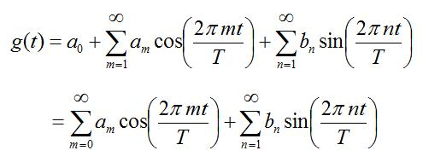
General Equation

Slide 6
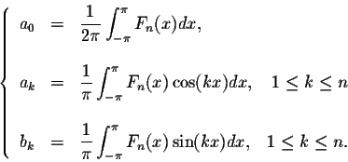
Coefficients

Slide 7
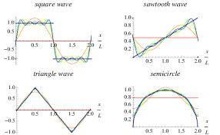
Representation

Slide 8
Objectives
A project objective describes the desired results of a project, which often includes a tangible item.
An objective should be specific, measurable and achievable.
It must meet time, budget, and quality constraints.

Slide 9
Methodology
What is your approach to the study (i.e., design and implementation)?
What data collection procedures will you employ?
How will you analyze the data?
How will you ensure the validity and reliability of the results?
You can prepare 3-4 slides for methodology, which should consists of flowchart/algorithm and required mathematics

Slide 10
GUI View
Draw the diagram of the front end of your project
How your application/project will look after completion?
Mention all options (buttons, windows, menu bar, etc….) in the diagram

Slide 11
Applications
List out the practical applications and real-life relevance of your project.

Slide 12
Time Plan
Phases | Weeks
 | 1 | 2 | 3 | 4
1. Literature Review | To conduct the literature survey and to final the Project Title.
2. ….. |  |  | xxxxxxxxxxxx
……
Testing
Validation
Report Writing
A tentative time plan layout is provided. You can modify it.
Add different project development phases in detail.
Prepare the plan from first week of August 2019 to Last week of Nov. 2019

Slide 13
References
Specify the references in IEEE style only.

